Slide 1

Life Management 2.0
Team Members: Lazaro Fernandez, Natalia Filippova, and Eric Rado Product Owner: Ranjeet Deshmukh Team Instructor: Masoud Sadjadi
Final Presentation
Fall 2017
Notes:
7 seconds.( I will select 2 best slides (i will give them extra points and students will present for CIS committee)
Greet your audience, thank them for attending your presentation, introduce yourself, introduce your project, introduce your team members, and quickly indicate what each of you did in a high-level manner, and put more emphasis on your part/contribution.

Slide 2


Problem
Social Media obsession makes life unorganized.
Many people lack purpose and happiness in their life.
People need help in finding what they want to achieve.

Slide 3


Solution
Android Application to manage daily activities and track progress throughout the time.
A place to contact Life Coaches for guidance and fulfillment.
Application that helps you reach your goal by doing what you like.

Slide 4
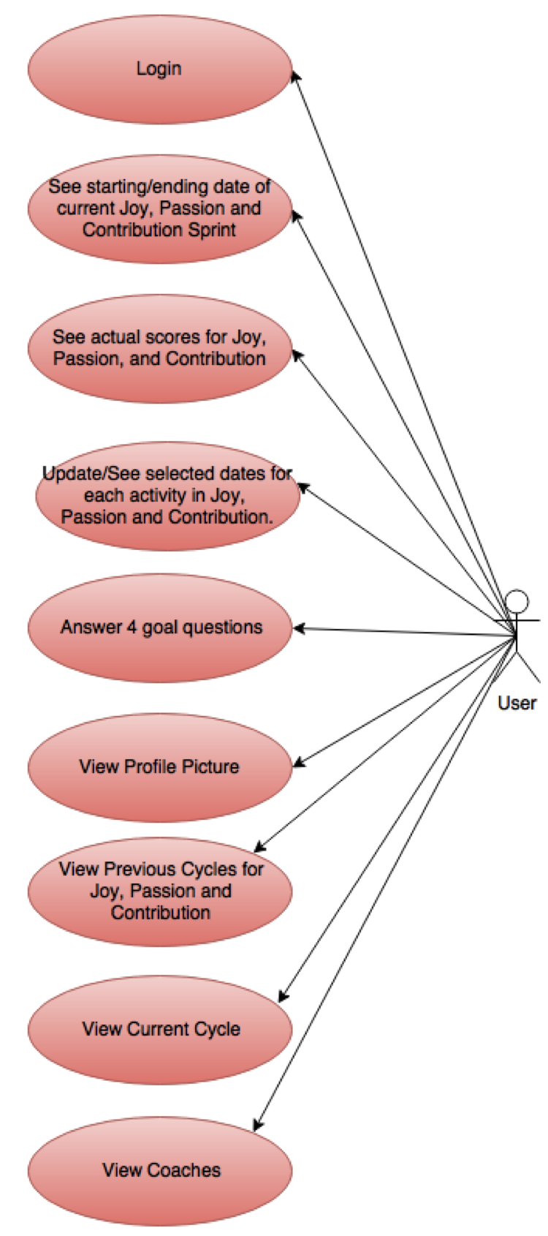
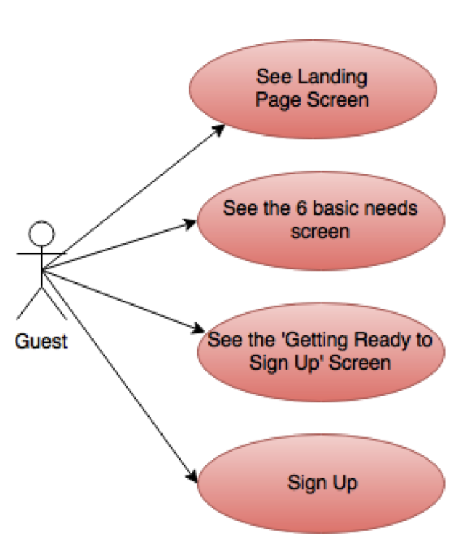
Use Case

Slide 5
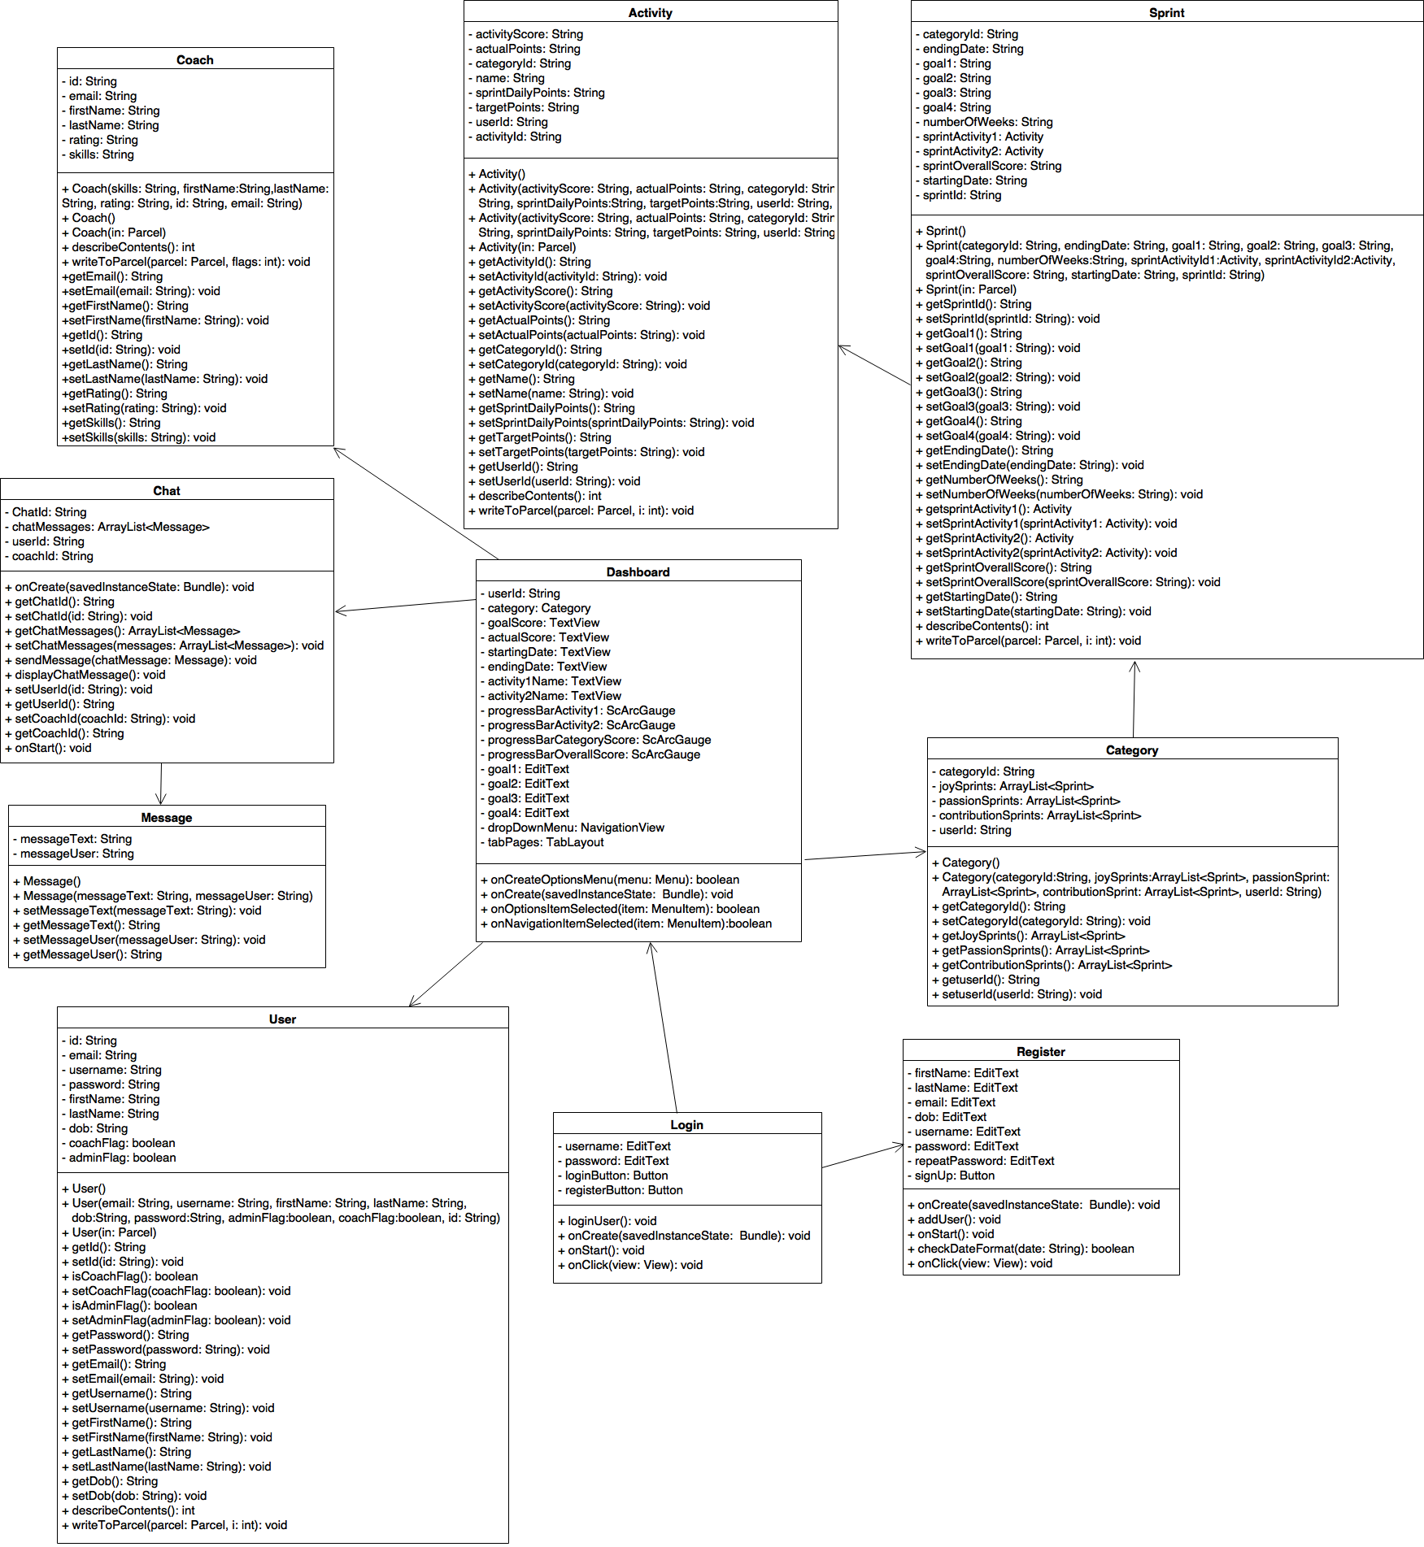
Minimal Class Diagram

Slide 6
Shortcomings/Wishlist
Settings Screen
Forgotten Password Retrieval
Let Coaches Login
Users can rate a coach
Users can share files with coaches
Users can create appointments with coaches
Users can invite friends to the app

Slide 7
Summary
This application allow users to plan and perform activities that gives them Joy, Passion and Contribution, allowing them to become a better person.
By using this app, they will become less addictive to social media.
Lazaro Fernandez, lfern216@fiu.edu
Natalia Filippova, nfili001@fiu.edu
Eric Rado, erado003@fiu.edu

